Slide 1
Unit-II
Mobile Radio Wave Propagation
(Large Scale Fading)
Path Loss

Slide 2
Introduction to Radio Wave Propagation
Follows the principle of Electromagnetic wave propagation
reflection
diffraction
scattering
Problems with urban areas
No direct line-of-sight
high-rise buildings causes severe diffraction loss
multipath fading due to different paths of varying lengths
Large-scale propagation models predict the mean signal strength for an arbitrary Tx-Rx separation distance. (generally for a larger distance).
Small-scale (fading) models characterize the rapid fluctuations of the received signal strength over very short travel distance or short time duration.

Slide 3
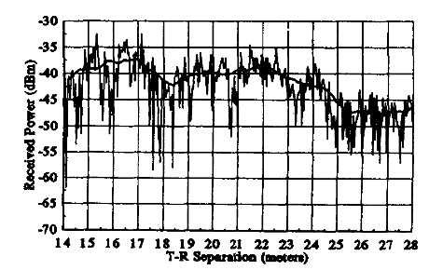
Large scale and Small scale fading

Slide 4
Radio wave propagation
Line of sight The line-of-sight (LOS) propagation is the wave propagation in which the EM ray follows a straight line from the transmitter to the receiver. It is shown as a direct ray in the next figure.
Non-line of sight The non-line-of-sight (NLOS) propagation mechanism is based on and is the resultant of the following mechanisms:
Reflection This occurs when the propagating wave impinges on an object that is larger than its wavelength. Examples of such objects are the surface of the earth, buildings, and walls.
Diffraction This occurs when the radio path between the transmitter and the receiver is obstructed by a surface with sharp irregular edges, which results in the waves bending around the obstacle. Diffraction is more with low- frequency (LF) signals than with high-frequency (HF)
Scattering This occurs when the propagating wave is obstructed by objects that are smaller than its wavelength. Examples of such objects are lamp posts, foliage, street signs, and particles in the air.
Refraction Due to variations in the refractive index of the atmospheric layers, the EM wave bends (in the cases other than satellite communication).

Slide 5
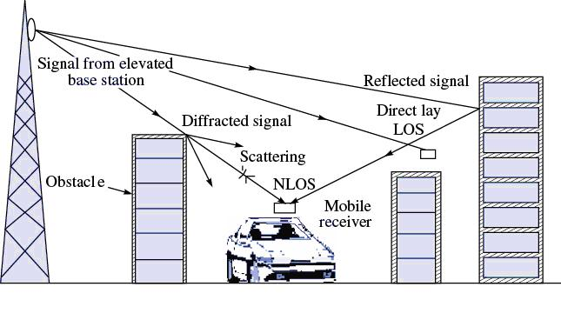
T-R Signal variations

Slide 6
Propagation Channel Effects
Attenuation It is the drop in the signal power when it is being transmitted from one point to another. It is caused by the transmission path length, obstructions in the signal path, and multipath effect.
Fading As there are obstacles and reflectors in the wireless propagation channel, the transmitted signal arrives at the receiver from various directions over multiple paths. Such a phenomenon is called multipath. Fading is the result of multipath in which the signal strength varies continuously with respect to distance and with time from the transmitter to the receiver along with the attenuation
Shadowing This occurs whenever there is an obstruction between the transmitter and the receiver, and it can be observed in long-distance as well as short distance communication. It is generally caused by buildings and hills.

Slide 7
Free Space Propagation Model
The free space propagation model is used to predict received signal strength when the transmitter and receiver have a clear line-of-sight path between them.
satellite communication
microwave line-of-sight radio link
Friis free space equation
: transmitted power : T-R separation distance (m)
: received power : system loss factor
: transmitter antenna gain : wave length in meters
: receiver antenna gain

Slide 8
The gain of the antenna
: effective aperture is related to the physical size of the antenna
The wave length is related to the carrier frequency by
: carrier frequency in Hertz
: carrier frequency in radians
: speed of light (meters/s)
The losses are usually due to transmission line attenuation, filter losses, and antenna losses in the communication system. A value of L=1 indicates no loss in the system hardware.

Slide 9
Isotropic radiator is an ideal antenna which radiates power with unit gain.
Effective isotropic radiated power (EIRP) is defined as
and represents the maximum radiated power available from transmitter in the direction of maximum antenna gain as compared to an isotropic radiator.
Path loss for the free space model with antenna gains
When antenna gains are excluded
The Friis free space model is only a valid predictor for , for values of d which is in the far-field (Fraunhofer region) of the transmission antenna.

Slide 10
The far-field region of a transmitting antenna is defined as the region beyond the far-field distance
where D is the largest physical linear dimension of the antenna.
To be in the far-filed region the following equations must be satisfied
and
Furthermore the following equation does not hold for d=0.
Use close-in distance and a known received power at that point
or

Slide 11
The Three Basic Propagation Mechanisms
Basic propagation mechanisms
reflection
diffraction
scattering
Reflection occurs when a propagating electromagnetic wave impinges upon an object which has very large dimensions when compared to the wavelength, e.g., buildings, walls.
Diffraction occurs when the radio path between the transmitter and receiver is obstructed by a surface that has sharp edges.
Waves bend around the obstacle, when LOS (line of sight) does not exist
Scattering occurs when the medium through which the wave travels consists of objects with dimensions that are small compared to the wavelength.

Slide 12
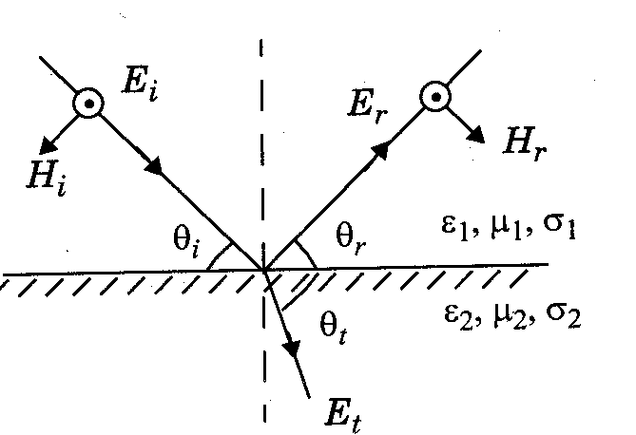
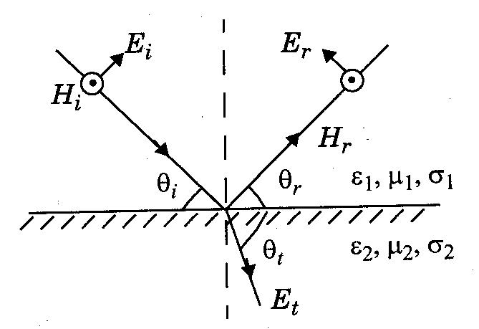
Reflection from dielectrics:
E-field normal to the plane of incidence E-field in the plane of incidence
Reflection from perfect Conductors:
E-field in the plane of incidence
θ_{i} = θ_{r} and E_{i} = E_{r}
E-field normal to the plane of incidence
θ_{i} = θ_{r} and E_{i} = -E_{r}

Slide 13
Diffraction model
RF energy can propagate:
around the curved surface of the Earth
beyond the line-of-sight horizon
Behind obstructions
Although EM field strength decays rapidly as Rx moves deeper into “shadowed” or obstructed (OBS) region
The diffraction field often has sufficient strength to produce a useful signal

Slide 14
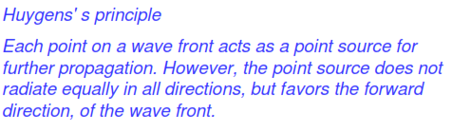
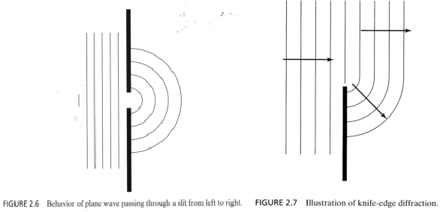
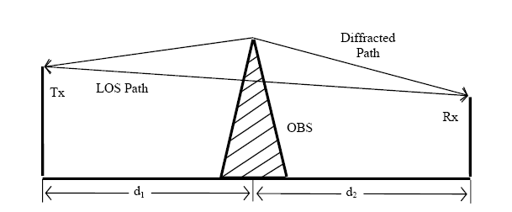
Huygen’s principle says points on a wavefront can be considered sources for additional wavelets.

Slide 15
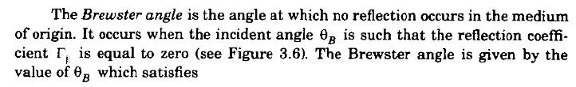



Slide 16
Scattering
Scattering occurs when the medium through which the wave travels consists of objects with dimensions that are small compared to the wavelength, and where the number of obstacles per unit volume is large.
Scattered waves are produced by
rough surfaces,
small objects,
or by other irregularities in the channel.
Scattering is caused by trees, lamp posts, towers, etc.

Slide 17
Scattering
Received signal strength is often stronger than that predicted by reflection/diffraction models alone
The EM wave incident upon a rough or complex surface is scattered in many directions and provides more energy at a receiver
energy that would have been absorbed is instead reflected to the Rx.
flat surface → EM reflection (one direction)
rough surface → EM scattering (many directions)

Slide 18
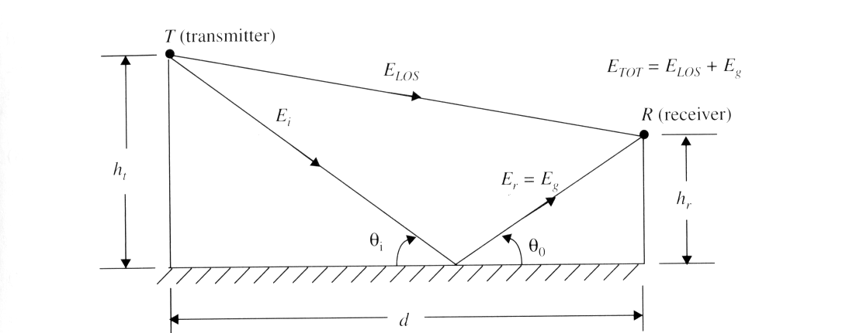
Classical 2-ray Ground Bounce Model
Two-ray ground reflection model
(Wireless Communications by Theodore Rappaport)
Notes:
Fig. 2.5

Slide 19
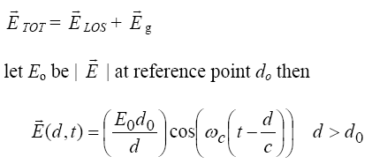


Classical 2-ray Ground Bounce Model
ETOT is the electric field that results from a combination of a direct line-of-sight path and a ground reflected path
is the amplitude of the electric field at distance d
ω_{c} = 2πf_{c} where f_{c} is the carrier frequency of the signal
Notice at different distances d the wave is at a different phase because of the form similar to

Slide 20


Classical 2-ray Ground Bounce Model
For the direct path let d = d’ ; for the reflected path
d = d” then
for large T−R separation : θ_{i} goes to 0 (angle of incidence to the ground of the reflected wave) and Γ = −1 (perfect horizontal E field polarization and ground wave reflection)
Phase difference can occur depending on the phase difference between direct and reflected E fields
The phase difference is θ∆ due to Path difference , ∆ = d”− d’, between
Notes:
ase difference
Path difference

Slide 21
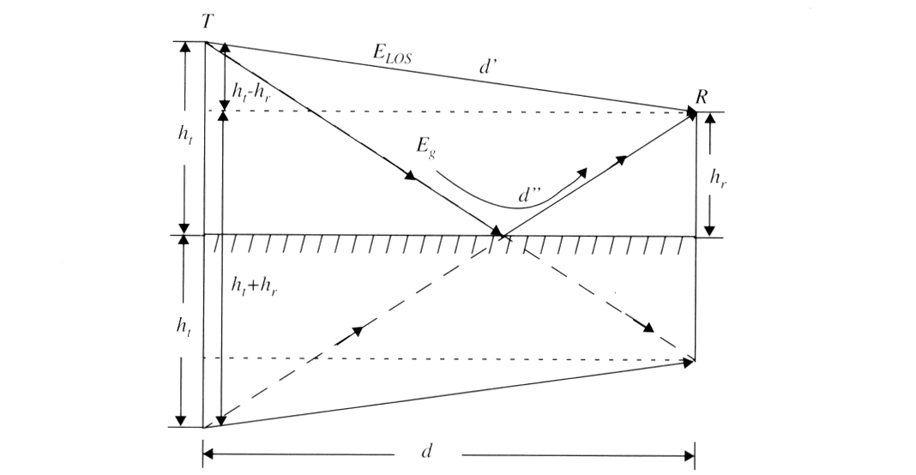
Method of Images
The method of images is used to find the path difference between the LOS and the ground reflected paths
(Wireless Communications by Theodore Rappaport)
Notes:
Fig. 2.6

Slide 22
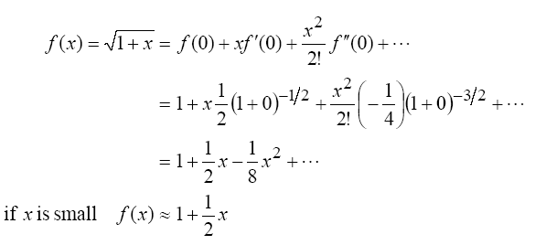
∆ can be expanded using a Taylor series expansion

Slide 23
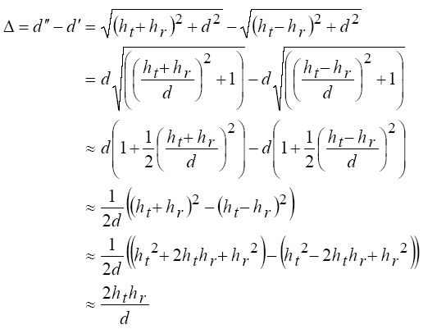


which works well for d >> (h_{t} + h_{r}), which means
and are small

Slide 24
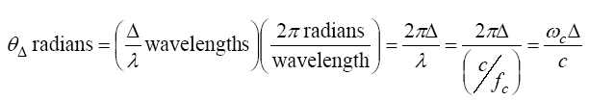
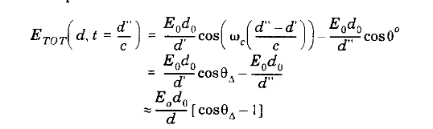
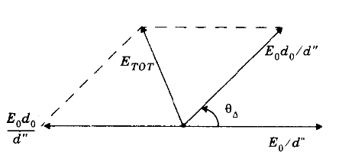
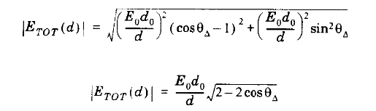
the phase difference between the two arriving signals is

Slide 25

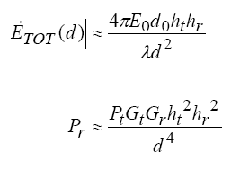
note that the magnitude is with respect to a reference of E₀=1 at d₀=100 meters, so near 100 meters the signal can be stronger than E₀=1
the second ray adds in energy that would have been lost otherwise
for large distances it can be shown that

Slide 26
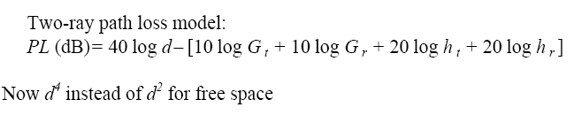



Slide 27
Free Space (LOS) Model
d=vt
Path loss for unobstructed LOS path
Power falls off :
Proportional to 1/d²
Proportional to λ² (inversely proportional to f²)

Slide 28
Ray Tracing Approximation
Represent wavefronts as simple particles
Geometry determines received signal from each signal component
Typically includes reflected rays, can also include scattered and defracted rays.
Requires site parameters
Geometry
Dielectric properties

Slide 29
Two Path Model
Path loss for one LOS path and 1 ground (or reflected) bounce
Ground bounce approximately cancels LOS path above critical distance
Power falls off
Proportional to d² (small d)
Proportional to d⁴ (d>d_{c})
Independent of λ (f)

Slide 30

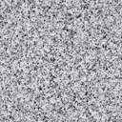
General Ray Tracing
Models all signal components
Reflections
Scattering
Diffraction
Requires detailed geometry and dielectric properties of site
Similar to Maxwell, but easier math.
Computer packages often used
_{(Wireless Communications by} _{Andrea Goldsmith)}

Slide 31
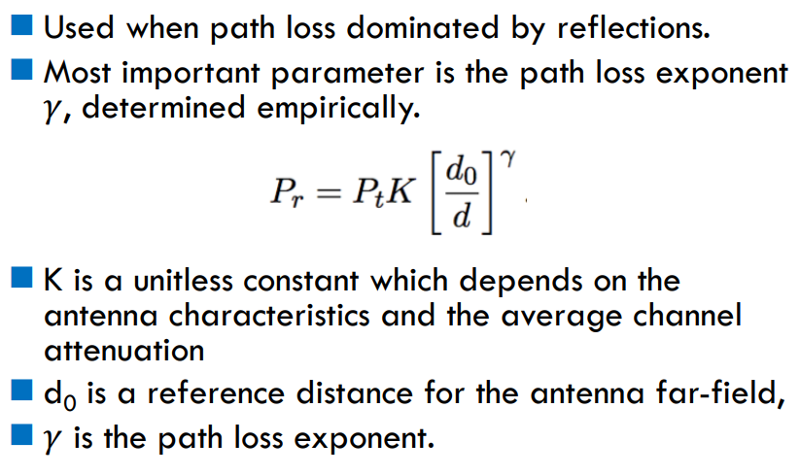
Simplified Path Loss Model

Slide 32
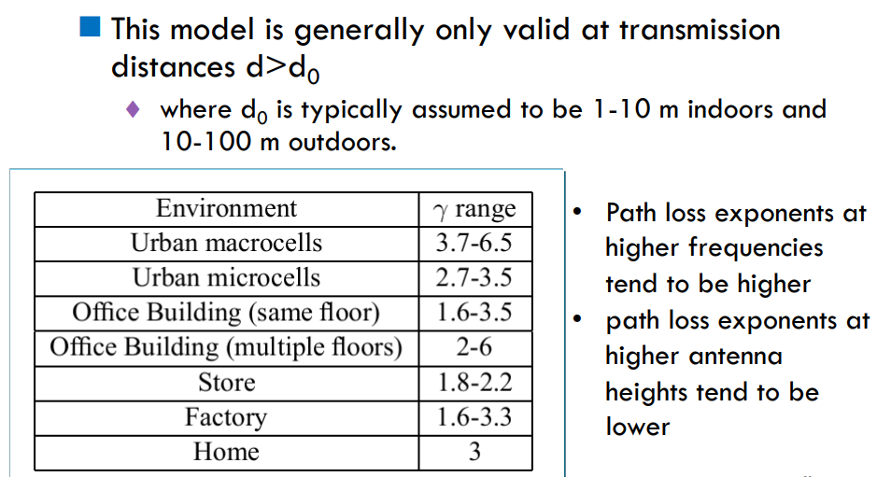
Simplified path loss model

Slide 33
Outdoor propagation Environment
Based on the coverage area, the Outdoor propagation environment may be divided into three categories
1. Propagation in Macro cells
2. Propagation in Micro cells
3. Propagation in street Micro cells

Slide 34
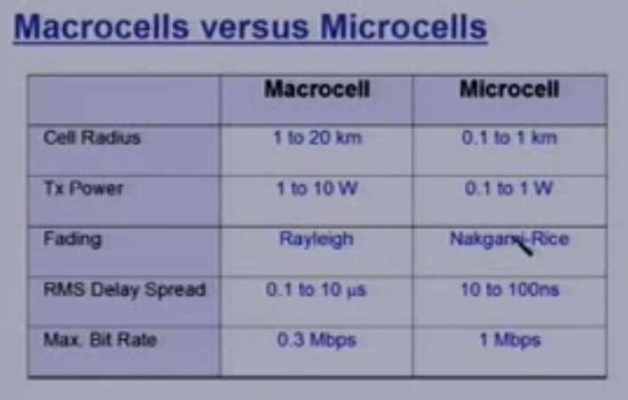
Outdoor propagation Environment

Slide 35
Empirical Models
Okumura model
Empirically based (site/freq specific)
Awkward (uses graphs)
Hata model
Analytical approximation to Okumura model
Cost 231 Model:
Extends Hata model to higher frequency (2 GHz)
Walfish/Bertoni:
Cost 231 extension to include diffraction from rooftops
Slope model
Commonly used in cellular system simulations

Slide 36
Outdoor propagation Models
Outdoor radio transmission takes place over an irregular terrain.
The terrain profile must be taken into consideration for estimating the path loss
e.g. trees buildings and hills must be taken
into consideration
Some common models used are
Longley Rice Model 1960s
Okumura Model 1968
Hatta model 1970s

Slide 37
Longley Rice Model
Longley Rice Model is applicable to point to point communication.
It covers 40MHz to 100 GHz
It can be used in wide range of terrain
Path geometry of terrain and the refractivity of troposphere is used for transmission path loss calculations
Geometrical optics is also used along with the two ray model for the calculation of signal strength.
Two modes
Point to point mode prediction
Area mode prediction

Slide 38
Longley Rice Model
Longley Rice Model is normally available as a computer program which takes inputs as
Transmission frequency
Path length
Polarization
Antenna heights
Surface reflectivity
Ground conductivity and dialectic constants
Climate factors
A problem with Longley rice is that It doesn't take into account the buildings and multipath.

Slide 39
Okumura Model
In 1968 Okumura did a lot of measurements and produce a new model.
The new model was used for signal prediction in Urban areas.
Okumura introduced a graphical method to predict the median attenuation relative to free-space for a quasi-smooth terrain
The model consists of a set of curves developed from measurements and is valid for a particular set of system parameters in terms of carrier frequency, antenna height, etc.

Slide 40
Okumura Model
First of all the model determined the free space path loss of link.
After the free-space path loss has been computed, the median attenuation, as given by Okumura’s curves has to be taken to account
The model was designed for use in the frequency range 200 MHz to 1920 MHz and mostly in an urban propagation environment.
Okumura’s model assumes that the path loss between the TX and RX in the terrestrial propagation environment can be expressed as:

Slide 41
Okumura Model
Estimating path loss using Okumura Model
1. Determine free space loss and A_{mu}(f ,d ), between points of interest
2. Add Amu(f ,d) and correction factors to account for terrain
L₅₀ = 50% value of propagation path loss (median)
L_{F} = free space propagation loss
A_{mu}(f,d) = median attenuation relative to free space
G(h_{te}) = base station antenna height gain factor
G(h_{re}) = mobile antenna height gain factor
G_{AREA} = gain due to environment
41

Slide 42
Okumura Model
A_{mu}(f,d) & G_{AREA} have been plotted for wide range of frequencies
Antenna gain varies at rate of 20dB or 10dB per decade
model corrected for
Δh = terrain undulation height, isolated ridge height
average terrain slope and mixed land/sea parameter
G(h_{te}) =
10m < h_{te} < 1000m
G(h_{re}) =
h_{re} ≤ 3m
G(h_{re}) =
3m < h_{re} <10m

Slide 43
Median Attenuation Relative to Free Space = A_{mu}(f,d) (dB)
70
60
50
40
30
20
10
Urban Area
h_{t} = 200m
h_{r} = 3m
100
80
70
60
50
40
30
20
10
5
2
1
d(km)
A_{mu}(f,d) (dB)
100 200 300 500 700 1000 2000 3000
f (MHz)
43

Slide 44
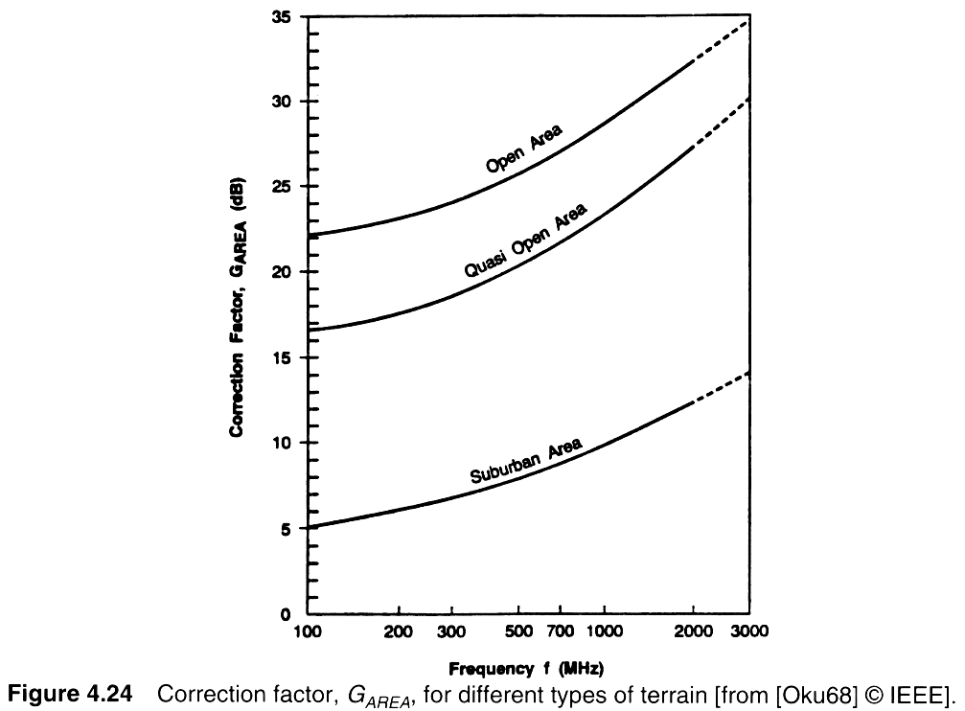
Correction Factor G_{AREA}

Slide 45
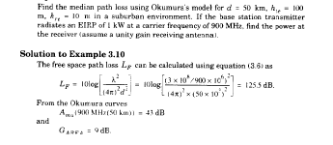
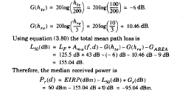
Example

Slide 46
Hata Model
Most widely used model in Radio frequency.
Predicting the behavior of cellular communication in built up areas.
Applicable to the transmission inside cities.
Suited for point to point and broadcast transmission.
150 MHz to 1.5 GHz, Transmission height up to 200m and link distance less than 20 Km.

Slide 47
Hata Model
Hata transformed Okumura’s graphical model into an analytical framework.
The Hata model for urban areas is given by the empirical formula:
L50, _{urban} = 69.55 dB +26.16 log(f_{c})- 3.82 log(h_{t}) -a(h_{r}) + (44.9 − 6.55 log(h_{t})) log(d)
Where L50, _{urban} is the median path loss in dB.
The formula is valid for
150 MHz<=f_{c}<=1.5GHz,
1 m<=h_{r}<=10m, 30m<=h_{t}<=200m,
1km<d<20km

Slide 48
Hata Model
The correction factor a(h_{r}) for mobile antenna height hr for a small or
medium-sized city is given by:
a(h_{r}) = (1.1 logf_{c} − 0.7)h_{r} − (1.56 log(f_{c}) − 0.8) dB
For a large city it is given by
a(h_{r}) = 8.29[log(1.54h_{r})]² − 1.10 dB for f_{c} <=300 MHz
3.20[log (11.75h_{r})]² − 4.97 dB for f_{c} >= 300 MHz
To obtain path loss for suburban area the standard Hata model is modified as
L₅₀ =L₅₀(urban)-2[log(f_{c}/28)]²-5.4
For rural areas
L₅₀ =L₅₀(urban)-4.78log(f_{c})²-18.33logf_{c} -40.98

Slide 49
COST 231 Extension of Hata Model
COST-231 Hata Model, European standard
Higher frequencies: up to 2GHz
Smaller cell sizes
Lower antenna heights
a(hr) is the same correction factor as before and CM is 0 dB for medium sized cities and suburbs, and 3 dB for metropolitan areas. This model is referred to as the COST-231 extension to the Hata model, and is restricted to the following range of parameters:
1.5GHz < fc < 2 GHz, 30m < ht< 200 m, 1m < hr < 10 m,
1Km <d< 20 Km.
Notes:
49

Slide 50
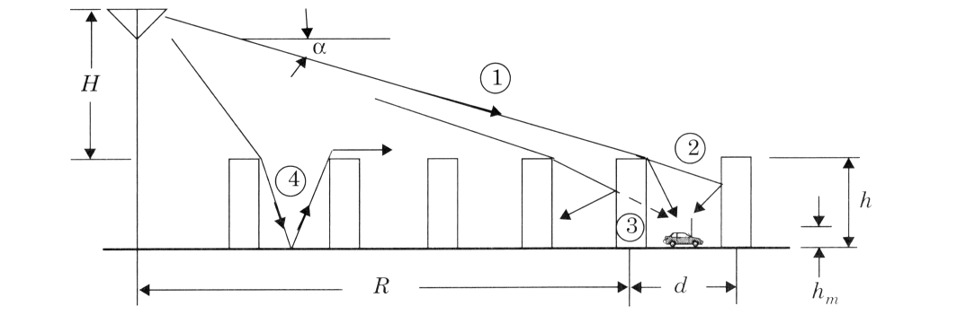
Walfisch and Bertoni’s Model
This model uses diffraction to predict average signal strength at street level. The model considers the path loss to be the product of three factors:
Q2 reflects the signal power reduction due to buildings that block the receiver at street level and P1 is based on the signal loss from the rooftop to the street due to diffraction.
(Wireless Communications by Theodore Rappaport)
Propagation geometry for model proposed by Walfisch and Bertoni
Notes:
Fig. 2.16

Slide 51
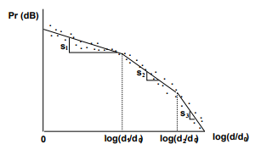

Piece wise linear model
Piecewise Linear Model for Path Loss.
A piecewise linear model with N segments must specify N − 1 breakpoints d1,...,dN−1 and the slopes corresponding to each segment s1,...,sN .
Dual-slope model

Slide 52
Indoor Models
Indoor Channels are different from traditional channels in two ways
1.The distances covered are much smaller
2.The variability of environment is much greater for a
much small range of Tx and Rx separation.
Propagation inside a building is influenced by:
- Layout of the building
- Construction materials
- Building Type: office , Home or factory
Floor losses, Partition losses, Penetration losses

Slide 53
Indoor Models
Indoor models are dominated by the same mechanism as out door models:
- Reflection, Diffraction and scattering
Conditions are much more variable
- Doors/Windows open or not
- Antenna mounting : desk ceiling etc
- The levels of floor
Indoor models are classifies as
- Line of sight (LOS)
- Obstructed (OBS) with varying degree of clutter

Slide 54
Indoor Models
Portable receiver usually experience
- Rayleigh fading for OBS propagation paths
- Ricean fading for LOS propagation path
Indoors models are effected by type of building e.g. Residential buildings, offices, stores and sports area etc.
Multipath delay spread
- Building with small amount of metal and hard partition
have small delay spread 30 to 60ns
- Building with large amount of metal and open isles
have delay spread up to 300ns

Slide 55
Partition losses (same floor)
Two types of partitions
1. hard partitions: Walls of room
2. Soft partitions : Moveable partitions that
do not span to ceiling
Partitions vary widely in their Physical and electrical properties.
Path loss depend upon the types of partitions

Slide 56
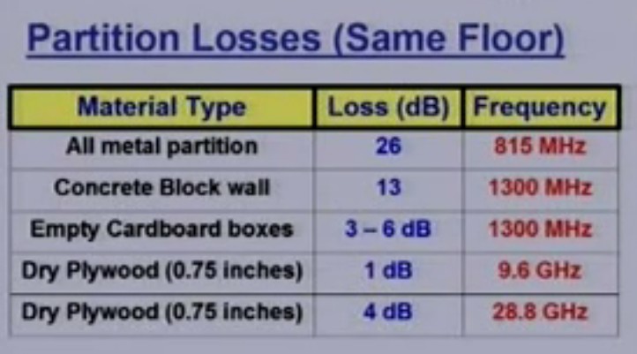
Partition losses (same floor)

Slide 57
Signal penetration into building
Effect of frequency
- Penetration loss decreases with increasing frequency
Effect of Height
Penetration loss decreases with the height of building up to some certain height.
- At lower heights the Urban clutter induces greater attenuation
- Up to some height attenuation decreases but then again
increase after a few floors
- Increase in attenuation at higher floors is due to the
Shadowing effects of adjacent buildings

Slide 58
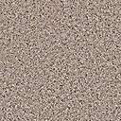
Shadowing
X_{c}
Models attenuation from obstructions
Random due to random # and type of obstructions
Typically follows a log-normal distribution
dB value of power is normally distributed
μ=0 (mean captured in path loss), 4<σ<12 (empirical)
LLN used to explain this model
Decorrelated over decorrelation distance X_{c}

Slide 59
Combined Path Loss and Shadowing
Linear Model: ψ lognormal
dB Model
10logΚ
Slow
P_{r}/P_{t}
(dB)
Very slow
-10γ
log d

Slide 60
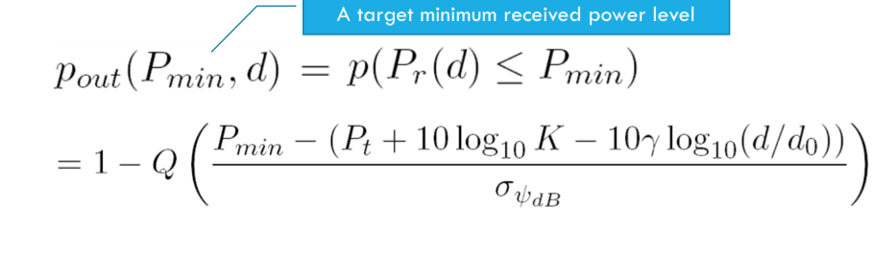
Outage Probability under path loss and shadowing

Slide 61
Cell Coverage Area
Path loss: circular cells
Path loss+shadowing: amoeba cells
Tradeoff between coverage and interference
Outage probability
Probability received power below given minimum
Cell coverage area
% of cell locations at desired power
Increases as shadowing variance decreases
Large % indicates interference to other cells
_{(Wireless Communications by}
_{Andrea Goldsmith)}

Slide 62
Main Points
Random attenuation due to shadowing modeled as log-normal (empirical parameters)
Shadowing decorrelates over decorrelation distance
Combined path loss and shadowing leads to outage and amoeba-like cell shapes
Cellular coverage area dictates the percentage of locations within a cell that are not in outage
Path loss and shadowing parameters are obtained from empirical measurements

